Slide 1
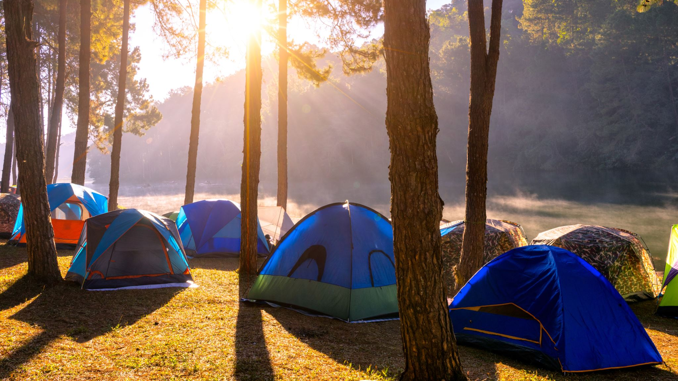
Tourist facilities – KDI Project
Javier Peña Enrico Micheli Devis Dal Moro

Slide 2



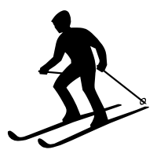
1. Scope
Platform to planify outdoor activities in Trentino
Skiing
Hiking
Biking
Accomodation
Lakes
…

Slide 3


1.1 Personas
Sergio
Professional Skiier
He spends most of the winter in Trentino training to become a better skier, which requires a mixture of sports like snowshoe or biking
He needs new places
Selma
Retired Swiss woman that wants to visit lakes in Trentino with her grandchildren
Looking for easy hiking trails
She really wants to spend the night in a hut/B&B

Slide 4
2. Inception - Competency queries
Persona | Query
Sergio | Retrieve the list options of bike trails in Trentino that are longer than 10 Km,with a high elevation and requires ex-pertise. Open during March.
Sergio | Find all the ski resorts, with more than 30km open of red or black slopes.
Selma | Find all the B&Bs in molveno offering breakfast under 75€/night
Selma | Find the hiking trails that start from Lago di Molveno, having a low difficulty, shorter than 2 hours and no equipment required

Slide 5





2.2 Initial Datasets
Trails, Snowshoe, Bike Trails and Huts
Lakes, Apartments, Hotels and Bed & Breakfast
Ski Areas

Slide 6
3. Informal Modelling
EER model based on the queries
Core Entities (Blue)
Contextual Entities (Green)
Common Entities (Red)

Slide 7
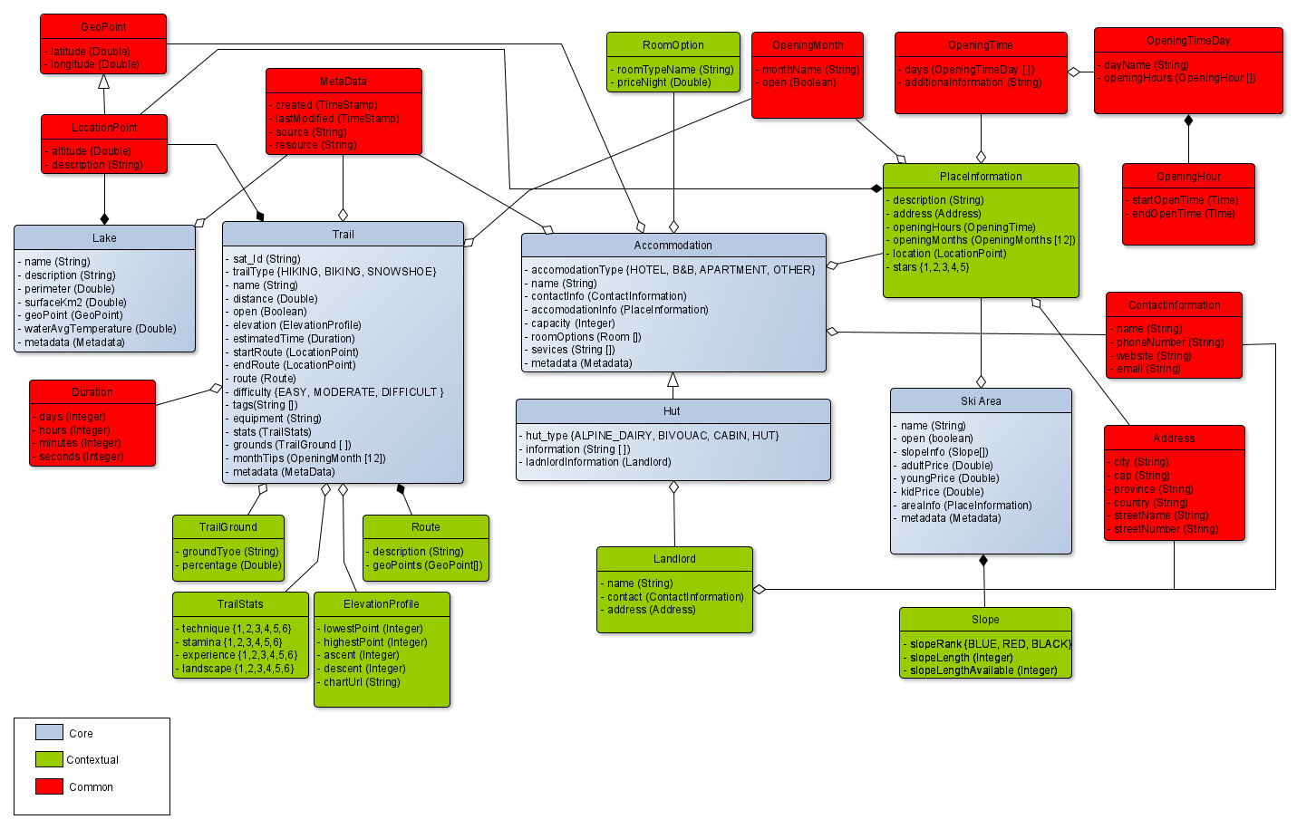
EER MODEL

Slide 8

3.3 Iteration
Ajustment of CQ to make them compliant with the datasets
Dataset cleaning and filtering to adjust them to the EER
Added additional information into the dataset

Slide 9

4. Formal Modeling
Explore and define concepts and relationships present in the EER
KOS UKC
Import missing concepts using the KOS API
Create the ontology in Protégé
Link to the UKC by annotations or globalID

Slide 10
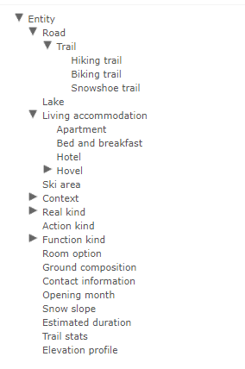
4. Formal Modelling
Use the API to export the Etypes into KOS

Slide 11
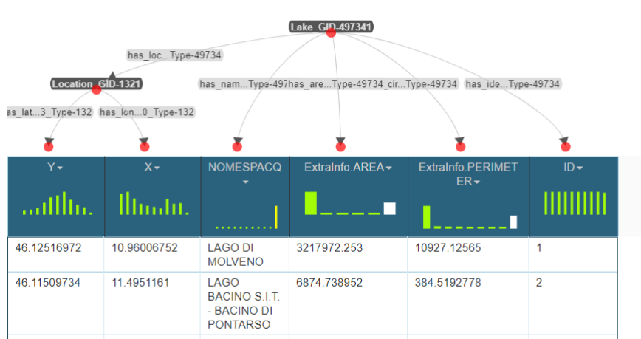
5. Data Integration
Additional Dataset cleaning to make them compatible with Karmalinker

Slide 12
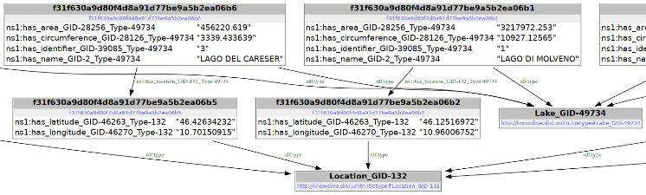
5. Data Integration
rdflibtools to visually inspect the generated DKG

Slide 13
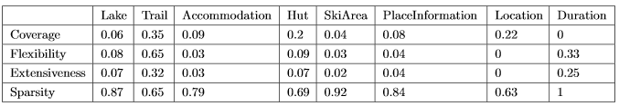
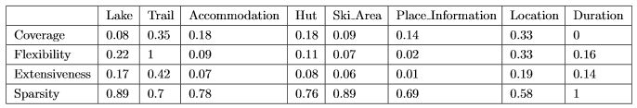
6. Evaluation
Informal modelling
Formal modelling

Slide 14
Thank you listening...
questions?

